Slide 1
Quantum vs. DNA Computing
In search for new computing methods
Petros Gkourasas
pgkouras@uwo.ca

Slide 2
What Is this all about?
Rise of the machines.
    1947 – “Six electronic computers would be enough for the computing needs of the U.S.A.”
Need for more computing power.
    Science, Education, etc
Search for a new computing medium.
    DNA or Quantum Computing
Is this feasible?

Slide 3
An overview.
Quantum Computing in a nutshell
DNA Computing review.
Theories & Applications for both methods
A comparison
Some thoughts
Parting words.
Maybe Q&A

Slide 4
Quantum Computing
“ A quantum computer is any device that exploits quantum mechanical phenomena to run algorithms”
- Geekwise.com

Slide 5
Quantum Computing: History
1981 - Paul Benioff, the first
1982 - Richard Feynman, realized that some quantum mechanic simulations can not be performed efficiently on a regular computer
1985 - David Deutsch. Description of a universal quantum machine

Slide 6
Quantum Computing: History (2)
1994 - Peter Shor, achieving polynomial time in factorization of integers made possible.
1996 - Lov Grover and quantum database search algorithm
1998 - 2001 - 2q, 3q, 5q, 7qbit computers, and execution of Shors’ factoring algorithm
2005 - 2006 - More Innovations.

Slide 7
Quantum Computing: Intro
Quantum phenomena?
    Superposition
      Bits vs Qubits
        (0 or 1) vs (0 or 1) or (0 and 1)
    Quantum parallelism: result of superposition
    Entanglement: allows us to know the spin of the opposite particle upon measurement.

Slide 8
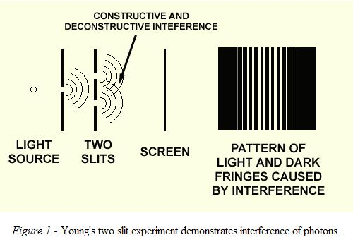
Intro(2): Interference
Interference: results can interfere since quantum computing can calculate multiple inputs at same time.
Interference is utilized by quantum algorithms
The result from each calculation of a universe will constructively and destructively interfere to give measurable result
Different significance for different algorithms

Slide 9
Intro(3): Decoherence
Tendency for qubit to fall back to one of either 0 or 1 state
This happens upon measurement, making solutions really hard to extract.
Why?

Slide 10
Intro(4): Strengths
Massive parallelism
    Because of coherent superposition
    2^(#of qubit) calculations at the same time!
Faster than the speed of light
    Entanglement: setting the spin of one particle instantaneously allows us to know spin of other.
Great for storage!

Slide 11
Quantum Computing: Future
David DiVincenzo, of IBM, listed the following requirements for a practical quantum computer:
  scalable physically to increase the number of qubits
  qubits can be initialized to arbitrary values
  quantum gates faster than decoherence time
  Turing-complete gate set
  qubits can be read easily

Slide 12
DNA Computing
“ DNA computing is a form of computing which uses DNA and molecular biology, instead of the traditional silicon-based computer technologies”
-Wikipedia.com

Slide 13
DNA Computing: History
1994 – L. Adleman solves Hamiltonian Path Problem
1995 – Boneh et al. paper on cracking DES using molecular computer
1997 – Rochester U. Team developed logic gates using DNA.
Many researchers have tried to follow Adlemans example.

Slide 14
DNA Computing: Intro
Deoxyribonucleic Acid
    Contains four different bases A, T, G, C
    Bases are complimentary and are responsible for the formation of the double helix.
Strengths
    Faster than classical computer systems
    Greater storage capacity
    Massive parallelism
    Lightweight
      1Lb gives us more computing power than all the computers ever made.

Slide 15
DNA Computing: Future
Many promising algorithms.
Lack of knowledge hinders progression
However, small and encouraging steps are being made
    2000 – development of gold plate applied with DNA

Slide 16
Theories
We will be looking at two algorithms dealing with:
    Cryptography
    Data storage searching ( databases )

Slide 17
Quantum Computing
Cryptography: breaking RSA (Shor, P. 1995).
Example: factor of number 15.

Slide 18
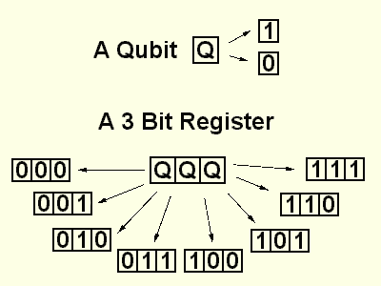
Cryptography – Shor – stage 1
8 different universes
All calculations are performed in parallel, one in each universe

Slide 19
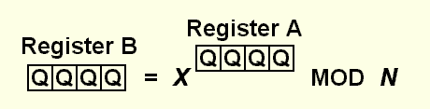
Cryptography – Shor – stage 2
N is the number we wish to factorise, N = 15
X is randomly chosen, where 1 < X < N-1
X is raised to the power contained in the register (register A) and then divided by N
The remainder from this operation is placed in a second 4 bit register (register B).

Slide 20
Cryptography – Shor – stage 2
Repeating values of 1, 2, 4, 8, all with frequency f = 4.
0 | 1
1 | 2
2 | 4
3 | 8
4 | 1
5 | 2
6 | 4
7 | 8
8 | 1
9 | 2
10 | 4
11 | 8
12 | 1
13 | 2
14 | 4
15 | 8

Slide 21

Cryptography – Shor – stage 3
f, can be found using a quantum computer.
We use interference to dispose cancel out values
Equation calculates possible value.

Slide 22
Grover’s Search algorithm
Similar to Shors’ algorithm
The information is in a register under superposition.
Interference cancels out wrong answers
Grover: “It’s like throwing stones in water, and let the ripples cancel out”.

Slide 23
Grover’s Search algorithm (2)
Possible to perform search in root N searches
The speed up that this algorithm provides is a result of quantum parallelism.
The database is effectively distributed over a multitude of universes, allowing a single search to locate the required entry.

Slide 24
Grover’s Search algorithm (3)
Application in cryptography as well.
Theoretically possible to break DES
Approximately 185 search cases vs. 2^55 on a regular computer.

Slide 25
Problems
Shors’ algorithm is probabilistic
Grovers’ algorithm is theoretically applicable to breaking DES
Technological issues:
    laser that manipulates qubit, fluctuates.
    dealing with decoherence.

Slide 26
DNA Computing
Following Joshs’ presentation in class it was said that RSA was on a “Provable security” level.

Slide 27
Algorithm for breaking DES with DNA computing.
Plan of attack [ Joshs’ presentation ]
  Oscar chooses some plaintext P and encrypts it using the DES circuit to obtain ciphertext C0
  Oscar wants to find the key k0 used in the circuit
  For every possible key ki (256 possibilities) Oscar creates a strand kiCi, where Ci is the ciphertext resulting from performing the encryption on P with potential key ki
  Similar to traveling salesman problem where Adleman generated all possible paths [Adleman 1994]
  Oscar now has a soup Tf containing 256 strands
  The strand for which Ci = C0 has the correct key ki

Slide 28
Problems
DNA computing is mostly theoretical
No killer app has been found.
DNA can solve most problems a typical computer can solve, not always more efficiently though ☹

Slide 29
Solutions
It seems that we are waiting for some advances in technology.
Increase of knowledge on biological field, and of biological operations, would aid progression.
Funding wouldn’t be bad either ☺

Slide 30
Problems: A Comparison
Quantum Computing is not as theoretical
Quantum Computing does have a killer app. “factorization of large numbers in polynomial time”
We have more knowledge on how quantum mechanics work, rather than how biological operation work.
In all fairness, quantum gets more funding.

Slide 31
Some thoughts (my own)
There is a need for more computational power
Both are excellent means of computation
    Viable alternatives to todays electronic computers
Don’t see them as competitive disciplines
    They compliment each other
      DNA focuses on storage capacity
      Quantum on speed
Future would be interesting to see!

Slide 32
Questions?

Slide 33
References
Geewise.com
http://www.wisegeek.com/what-is-aquantumcomputer.htm?referrer=adwords_campaign=quantumcomputer_ad=027381&_search_kw=quantum%20computing
How stuff works.
http://computer.howstuffworks.com/quantum-computer.htm
http://computer.howstuffworks.com/framed.htm?parent=dna-computer.htm&url=http://www.news.wisc.edu/view.html?id=3542
An Introduction to Quantum Computing for Non-Physicists
Authors: Eleanor G. Rieffel, Wolfgang Polak
Date (v1): Tue, 8 Sep 1998 19:02:58 GMT (47kb)
Date (revised v2): Wed, 19 Jan 2000 01:48:39 GMT (67kb)
A Brief History of Quantum Computing
By Simon Bone and Matias Castro
http://www.doc.ic.ac.uk/~nd/surprise_97/journal/vol4/spb3/
An Introduction in Quantum Computing.
http://www.cs.caltech.edu/~westside/quantum-intro.html

Slide 34
References (2)
Wikipedia
http://en.wikipedia.org/wiki/Timeline_of_quantum_computing
Microsoft @ quantum computing.
http://www.engineering.uiowa.edu/~jmhoward/RESEARCH/QC-1.ppt
Caltech
http://www.theory.caltech.edu/~quic/errors.html
Grover L.K.: A fast quantum mechanical algorithm for database search, Proceedings, 28th Annual ACM Symposium on the Theory of Computing, (May 1996)
Bennett C.H., Bernstein E., Brassard G., Vazirani U., The strengths and weaknesses of quantum computation. SIAM Journal on Computing
Polynomial-Time Algorithms for Prime Factorization and Discrete Logarithms on a Quantum Computer, Peter W. Shor
http://tech.suramya.com/dna_computing/

